Slide 1
Darren Crowley
Responsible Investing and Performance
Nov 2023

Slide 2
For more information, please contact
disclaimer
Pictet Asset Management SA
Route des Acacias 60
1211 Geneva 73
Tel: +41 58 323 3333
Fax: +41 58 323 2040
assetmanagement.pictet
This marketing material has been issued in Switzerland by Pictet Asset Management SA and in the rest of the world by Pictet Asset Management (Europe) SA. It is neither directed to, nor intended for distribution or use by, any person or entity who is a citizen or resident of any locality, state, country or other jurisdiction where such distribution, publication, or use would be contrary to law or regulation.
The information and data presented in this document are not to be considered as an offer or solicitation to buy, sell or subscribe to any securities or financial instruments or services.
Information used in the preparation of this document is based upon sources believed to be reliable, but no representation or warranty is given as to the accuracy or completeness of those sources. Any opinion, estimate or forecast may be changed at any time without prior warning. Investors should read the prospectus or offering memorandum before investing in any Pictet managed funds. Tax treatment depends on the individual circumstances of each investor and may be subject to change in the future. Past performance is not a guide to future performance. The value of investments and the income from them can fall as well as rise and is not guaranteed. You may not get back the amount originally invested.
The investment guidelines are internal guidelines which are subject to change at any time and without any notice within the limits of the fund's prospectus.
The mentioned financial instruments are provided for illustrative purposes only and shall not be considered as a direct offering, investment recommendation or investment advice. Reference to a specific security is not a recommendation to buy or sell that security. Effective allocations are subject to change and may have changed since the date of the marketing material.
Pictet AM has not acquired any rights or license to reproduce the trademarks, logos or images set out in this document except that it holds the rights to use any entity of the Pictet group trademarks. For illustrative purposes only.
This document has been issued in Switzerland by Pictet Asset Management SA and in the rest of the world by Pictet Asset Management (Europe) SA, and may not be reproduced or distributed, either in part or in full, without their prior authorisation.
© COPYRIGHT 2023.
SOURCES: ALL DATA TAKEN FROM PICTET GROUP.

Slide 3
Delivering on our ambitions
Responsible investment at pictet group
As a firm, responsibility starts with what we do with our own assets
As an investor, our biggest impact lies in how we manage assets on behalf of our clients
Own assets
Client assets
1
Balance sheet
2
Employee engagement
6
ESG integration
7
Products & solutions
3
Direct environmental impact
4
Philanthropy
8
Active ownership
9
Client disclosure
5
Advocacy & partnerships
10
Research & thought-leadership
Source: Pictet Group – 2023

Slide 4
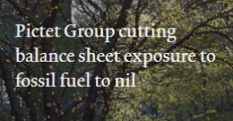
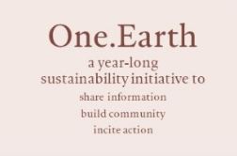
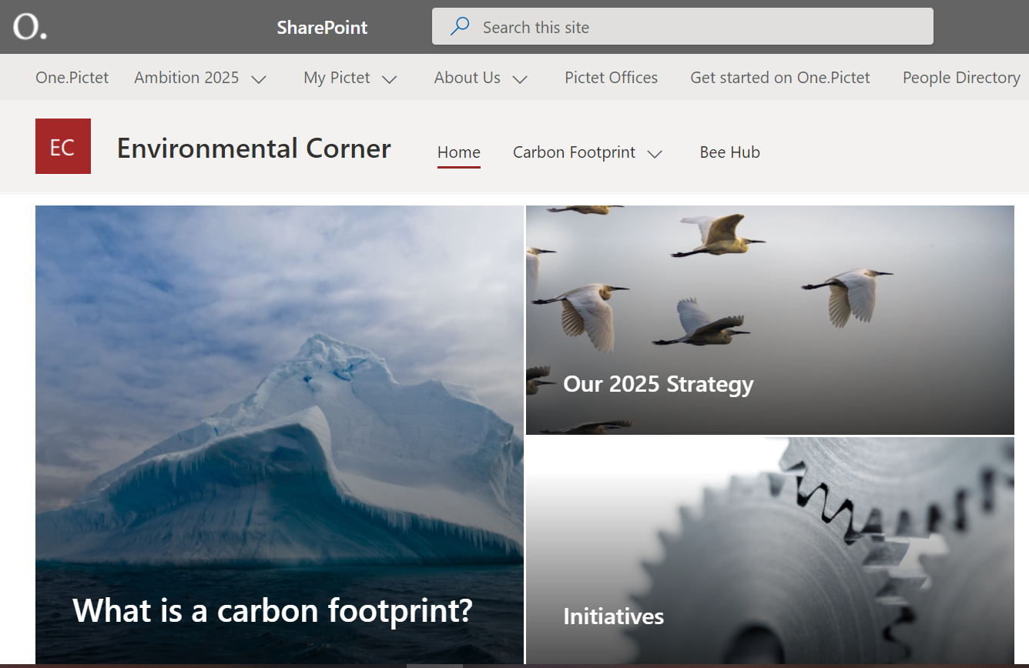








Our own assets
Responsible investment at pictet group
As a firm, responsibility starts with what we do with our own assets
Investing our balance sheet | Eliminating balance sheet exposure of the Pictet Group to fossil fuel producers and extractors
Employee engagement to foster responsibility | Employees benefit from a diverse programme of leading experts during our internal year-round awareness initiative dedicated to environmental and social issues
Managing our direct environmental impacts | By 2025, Pictet aims to cut its direct greenhouse gas emissions by 60% compared with 2019 levels, with residual emissions mitigated through an approach that includes removing carbon from the atmosphere
Philanthropy for environmental and social benefit | Pictet Group Foundation since 2009 A clear focus on Water and Nutrition
Advocacy and partnerships | 2007: Early signatory of the PRI 2008: Launch of Prix Pictet, a photography award aiming to raise awareness of and promote action in environmental sustainability A commitment to Net Zero Asset Managers Initiative and the Science-Based Target Initiative for 1.5 degrees Strategic collaboration with Ceres around Water Action
Source: Pictet Group – 2023
Cutting edge infrastructure
Mindful travel and green mobility
Smarter consumption

Slide 5
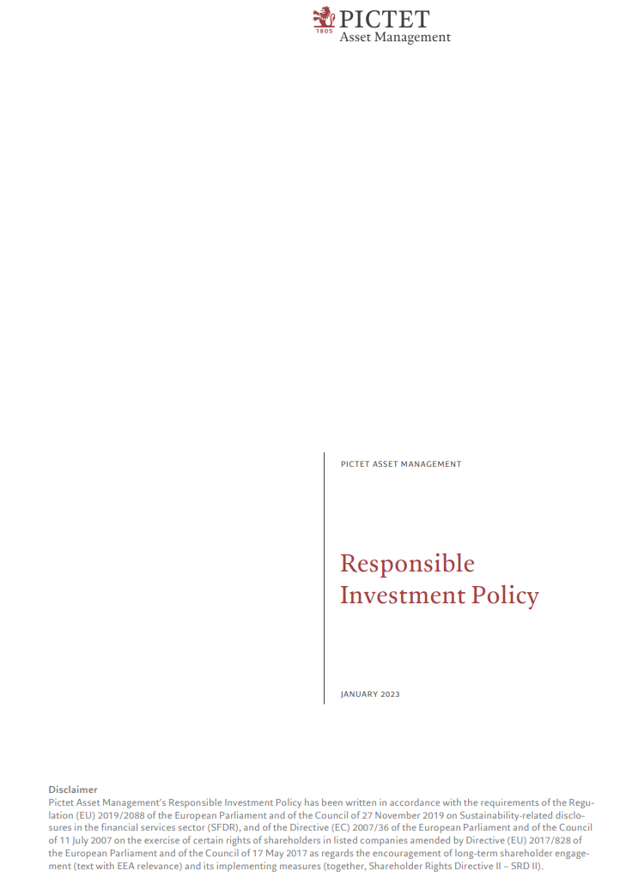
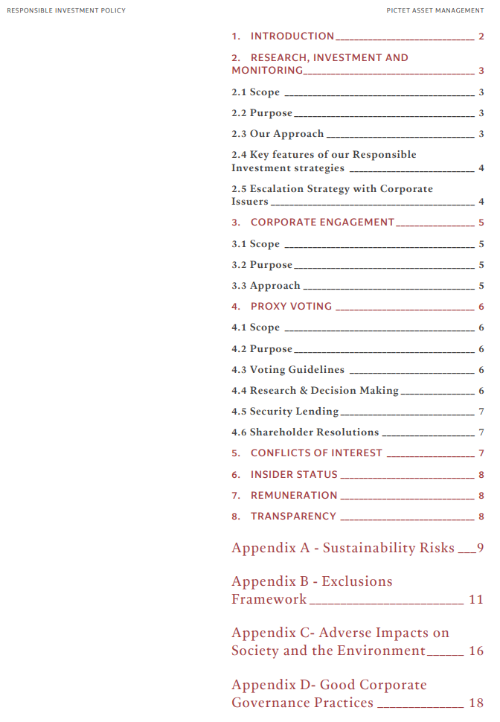


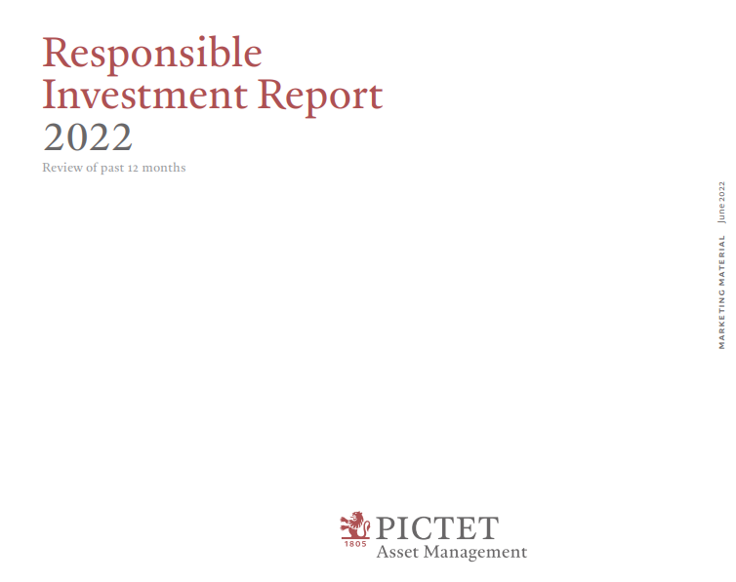
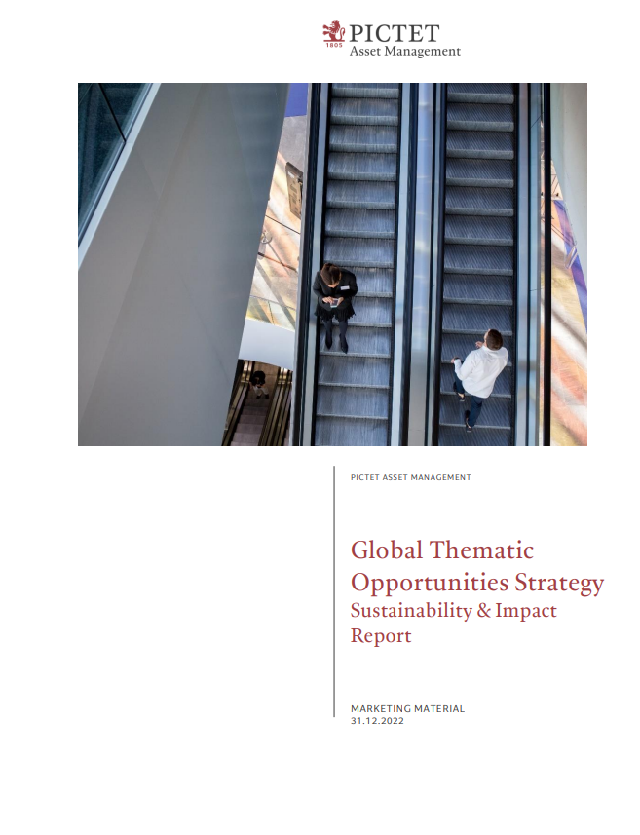
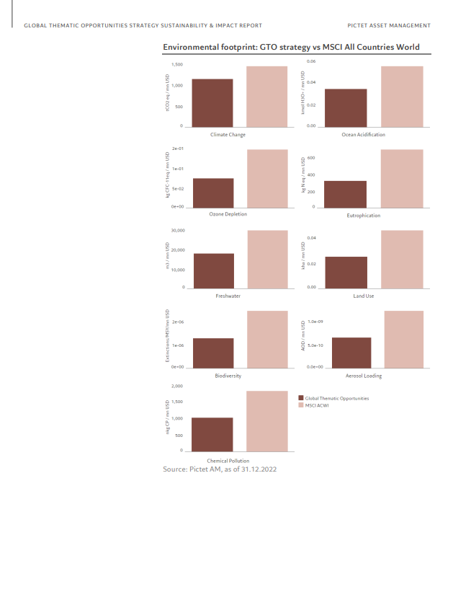
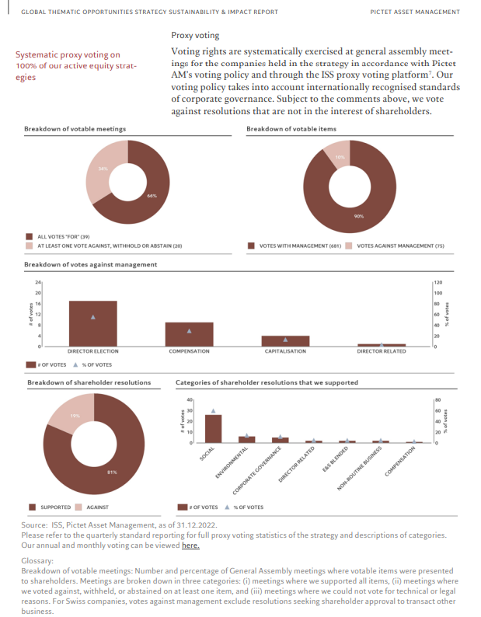





Our client assets
Responsible investment at pictet group
As an investor, our biggest impact lies in how we manage assets on behalf of our clients
ESG integration into investment processes and risk management | Robust framework supported by a dedicated ESG team of 7 senior professionals and a network of 50 ESG champions Proprietary ESG scorecard based on leading edge internal and external research
Responsible products and solutions | c.86% of funds are Art 8 or Art 9 under SFDR¹ Innovative product range across various asset classes: Equity (eg Thematic franchise, Positive Change), Fixed Income (eg Sustainable Credit, EMD Sustainable Blend, Global Climate Bonds) and Multi-Asset (eg LPP Sustainable)
Active ownership | First-mover in open letter to index providers on controversial weapons exclusion Voting at over 4,000 company meetings every year Group engagement programme targeting 100+ companies focusing on Climate Change, Water, Nutrition and Long-Termism
Client disclosure | Extended reporting at portfolio-level and firm-wide
Research & thought-leadership
¹Regulation (EU) 2019/2088 of the European Parliament and of the Council of 27 November 2019 on Sustainability-related disclosures in the financial services sector (SFDR). Please note that the assets stated include all assets which are either managed or distributed by Pictet Asset Management excluding mandates, and which are in scope for SFDR. For methodological reasons, AUM figures shown above may differ from those shown in other marketing material on Pictet Asset Management. Source: Pictet Asset Management, 30.06.2023
            Responsible Investment policy

Slide 6



ESG integration into investment processes and risk management
ESG integration
ESG factors
We are including ESG factors* across all research, investment decisions, and risk management
Pictet ESG scorecard
Our proprietary ESG Scorecard provides a focused view of ESG Risks and Opportunities for Corporate & Sovereign issuers
    Physical risks of climate change
    Transition risks of climate change
    Greenhouse gas (GHG) emissions
    Waste and pollution
Environmental
Corporate governance
Are companies managed
for the long-term?
    Labour standards
    Human rights
    Workplace health and safety
    Diversity
Social
Product & services
How «future-fit/SDG compatible»
is their product-mix?
Operational risks
How do they run their
business?
    Executive pay
    Bribery & corruption
    Business ethics
Governance
Controversies
Are they walking the talk?
Source: Pictet Asset Management, 30.06.2023
*The list includes, but is not limited to the factors listed above.
Note: illustration covers the framework for corporate issuers
Notes:
Refaire

