Slide 1
JOURNAL OF
PERFORMANCE
MEASUREMENT
Using Rodney Dangerfield (and Vectors) to Explain Risk-Adjusted
Performance
Annual Conference 2025
🏆 DIETZ AWARD
Best Paper of 2025
Journal of Performance Measurement
A new visual field of finance — Vector Finance —
where portfolios are vectors, correlations are cosines,
and risk-adjusted performance becomes geometry.
AUTHORS
Arun Muralidhar, Ph.D.
Founder, Mcube Investment Technologies
Adjunct Professor, Georgetown University
Lester Seigel, Ph.D.
Head of Financial Engineering, World Bank Treasury
Adjunct Professor, Georgetown University
Spring 2025 · Journal of Performance Measurement

Slide 2
Presentation Roadmap
Dietz Award Keynote · 2025
The Problem
Luck vs. Skill
01
02
Why CAPM-based measures fail to rank managers by skill
The Ambarish-Seigel framework and its key variables
M-cube Measure
Vector Finance
03
04
Dual normalization: volatility AND correlation
Portfolios as vectors, correlation as cosine
Time Varying Skill
Conclusion
05
06
Some new research
Opening new fields for better results
Muralidhar & Seigel · JPM Spring 2025
Dietz Award Best Paper
2

Slide 3
01 · THE PROBLEM
Rodney Dangerfield on Being Ugly..
When I was born, I was so ugly……
The doctor slapped my mother!!
Muralidhar & Seigel · JPM Spring 2025
Dietz Award Best Paper
3

Slide 4
01 · THE PROBLEM
Why Do CAPM-Based Measures Fail?
Four Realities of Investing
The Measurement Gap
Investors' goals are stochastic — benchmarks have non-zero volatility
Sharpe Ratio
1
Only normalizes for absolute volatility — ignores correlation entirely
Investors have multiple stochastic goals: retirement, education, health, and more
Modigliani M²
2
Normalizes volatility but leaves correlation unconstrained across funds
Investors delegate to (hopefully) skillful agents — internal staff or external managers
Graham-Harvey
3
Same oversight — each fund ends with different tracking errors
Risk preferences are specified in clear absolute AND relative risk goals
The Flaw
4
Every manager still has a different ρ(A,L) or tracking error — making comparison impossible
Cannot use CAPM Measures for External Managers as CAPM DOES NOT have Delegation!
Muralidhar & Seigel · JPM Spring 2025
Dietz Award Best Paper
3

Slide 5

An Evaluation of the M² Measure
Need to normalize for different Std. deviations
Return
Active portfolio
Active portfolio
Benchmark
Riskless asset
Market risk
Standard deviation
Standard deviation of unlevered portfolio

Slide 6
M-Square was better than Sharpe (as a Ratio means nothing..)
“You can eat risk-adjusted returns” – gave useful allocation information
Underperforming Portfolio has a Higher Risk-Adjusted Return!!
Return
Benchmark
Riskless asset
Market risk
Standard deviation
Problem: Need to normalize for different correlations

Slide 7
02 - LUCK vs SKILL
Rodney Dangerfield on Seeing the Light..
My wife used to be scared of the dark……
Then she saw me naked –
Now she is scared of the light!!
Muralidhar & Seigel · JPM Spring 2025
Dietz Award Best Paper
3

Slide 8
The Real-World Mandate: Want Skillful Managers!!
“
The Fund's long-term performance objective is to generate risk-adjusted returns
that meet or exceed its defined actuarial target as well as its policy benchmark,
net of fees, over the Fund's designated investment time horizon.“
IPS also includes a very specific volatility (10.5% p.a.) and tracking error target (1.5% p.a.)
— LACERA Investment Policy Statement (Los Angeles County Employees' Retirement Association); New Mexico Public Employees’ Retirement Association is similar
Stochastic Goal
Absolute and Relative Risk Matters
Correlation is Critical
The actuarial target IS the benchmark — it has non-zero volatility, making it stochastic
Performance must be measured relative to the goal, NOT just in absolute space
Tracking error requires BOTH volatility AND correlation — you cannot skip either
Muralidhar & Seigel · JPM Spring 2025
Dietz Award Best Paper
4

Slide 9
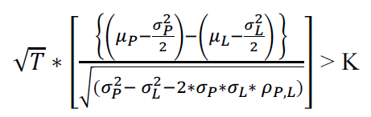
02 · LUCK VS. SKILL
The Ambarish-Seigel Framework
Core Insight
The Skill Condition (Eq. 9b)
Outperforming a benchmark does not tell you whether an agent is skillful.
Even the information ratio (IR) is insufficient — it normalizes for relative risk, but does not tell you the confidence level that excess returns reflect skill rather than noise.
Tracking Error (denominator)
Variables That Determine Skill Confidence
More volatility → More noise → More time needed
T — Length of track record
K — Desired confidence level (# std. deviations)
Higher correlation → Lower TE → Easier to detect skill
σP, σL — Portfolio and benchmark volatilities
ρP,L — Correlation between portfolio and benchmark
Dual role of ρ: affects BOTH skill confidence AND risk-adjusted ranking
μP − μL — Excess return of the portfolio over the benchmark
Muralidhar & Seigel · JPM Spring 2025
Dietz Award Best Paper
5

Slide 10
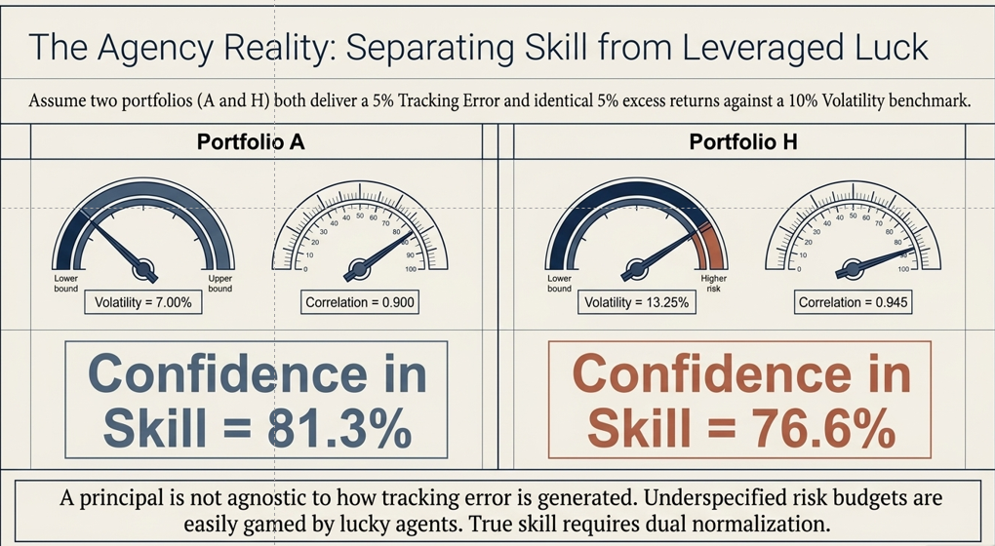
Manager’s Skill : Is Very Important for Portfolios
Performance Data is Noisy – Do Not Want to Hire Lucky Managers
Using Ambarish-Seigel (1996) Measure

Slide 11
03 – MCUBE MEAUSRE
Rodney Dangerfield on Second Opinions
My psychiatrist told me I am crazy.
I told him I want a second opinion.
He said, OK – you are ugly too!!
Muralidhar & Seigel · JPM Spring 2025
Dietz Award Best Paper
3

Slide 12
03 · M-CUBE MEASURE
The M-cube Risk-Adjusted Performance Measure
OBJECTIVE:
Maximize E[r(A) − r(L)]
subject to σ(A) = σ(L) AND TE(A, L) = τ
Portfolio A
Volatility Constraint
Tracking Error Constraint
A = a·P + l·L + (1−a−l)·F
a = allocation to agent portfolio
l = allocation to benchmark (beta)
(1−a−l) = allocation to risk-free asset
σ(A) = σ(L)
Forces risk-adjusted portfolio to have identical absolute volatility to the goal — the first normalization
TE(A, L) = τ
Forces identical relative risk (tracking error)for ALL managers — the second normalization
(this is what M² misses!)
RESULT: With M-cube, every manager's ρ(A,L) = ρ(τ,L) — identical for all.
M-cube excess return ranking ≡ Ambarish-Seigel skill ranking — no other measure achieves this.
Muralidhar & Seigel · JPM Spring 2025
Dietz Award Best Paper
6

Slide 13
M-cube: Ranks Agents Identical to Confidence in Skill
Because it is the only measure that has DUAL NORMALIZATION of volatility and correlation
Sharpe Ratio, Modilgiani-Modigliani; Graham-Harvey Do Not!

Slide 14
04 – VECTOR FINANCE
Rodney Dangerfield on Using Pictures..
I am so ugly…
My dad carries around the picture of the kid that came with the wallet
Muralidhar & Seigel · JPM Spring 2025
Dietz Award Best Paper
3

Slide 15
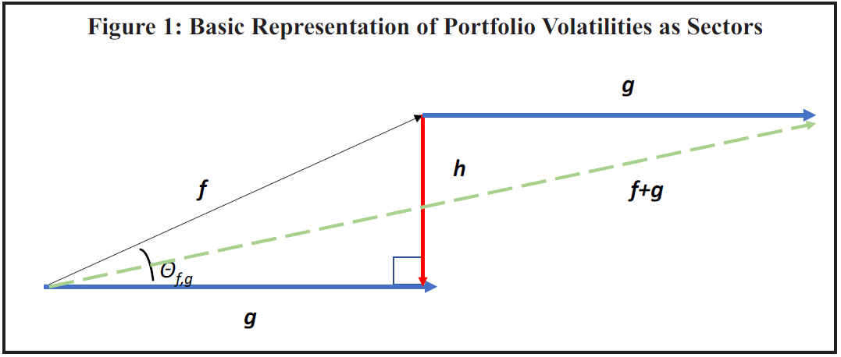
Vector Finance: A New Framework (Basics)
Portfolios ARE Vectors
Correlation IS a Cosine
Direction → positive or negative expected return
Magnitude → volatility of the portfolio (σ)
Combinations → linear combinations = portfolio construction
ρ(f, g) = cos(θ_{f,g})
The angle between two vectors = their correlation.
Orthogonal vectors = zero correlation.
Parallel vectors = perfect correlation.
Vectors
Muralidhar & Seigel · JPM Spring 2025
Dietz Award Best Paper
7

Slide 16
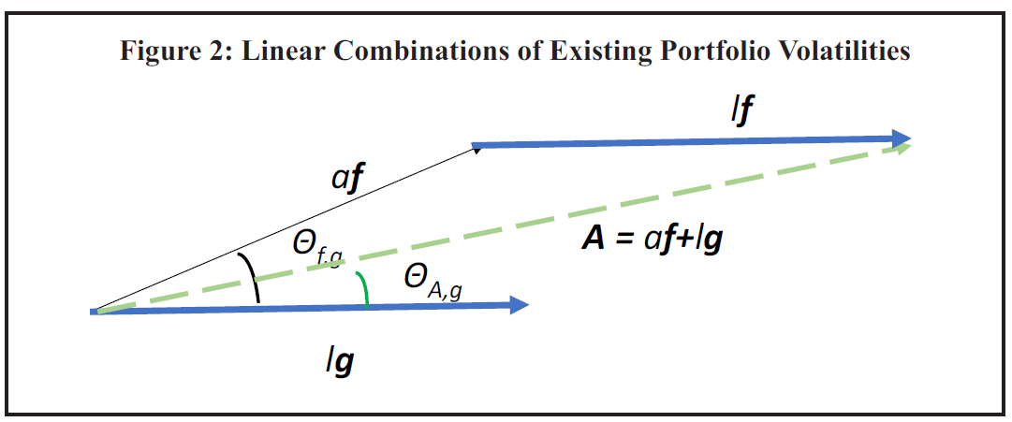
Vector Finance: Combining Portfolios – Linear Combinations
lg
Muralidhar & Seigel · JPM Spring 2025
Dietz Award Best Paper
7

Slide 17
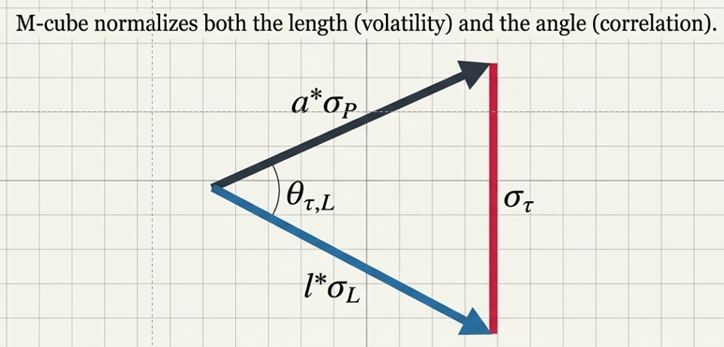
Vector Finance: A New Framework
Portfolios ARE Vectors
Correlation IS a Cosine
Direction → positive or negative expected return
Magnitude → volatility of the portfolio (σ)
Combinations → linear combinations = portfolio construction
ρ(f, g) = cos(θ_{f,g})
The angle between two vectors = their correlation.
Orthogonal vectors = zero correlation.
Parallel vectors = perfect correlation.
Three Powerful Consequences
Tracking Error
TE² = σ_{f}² + σ_{g}² − 2σ_{f}σ_{g} cos(θ) is just the Law of Cosines — the 'bi-vector' σ_{h}
Portfolio Construction
A = aP + lL is vector addition — scalars stretch/flip direction
M-cube Geometry
Constraining TE = τ means constraining θ to be identical for ALL managers
Muralidhar & Seigel · JPM Spring 2025
Dietz Award Best Paper
7

Slide 18
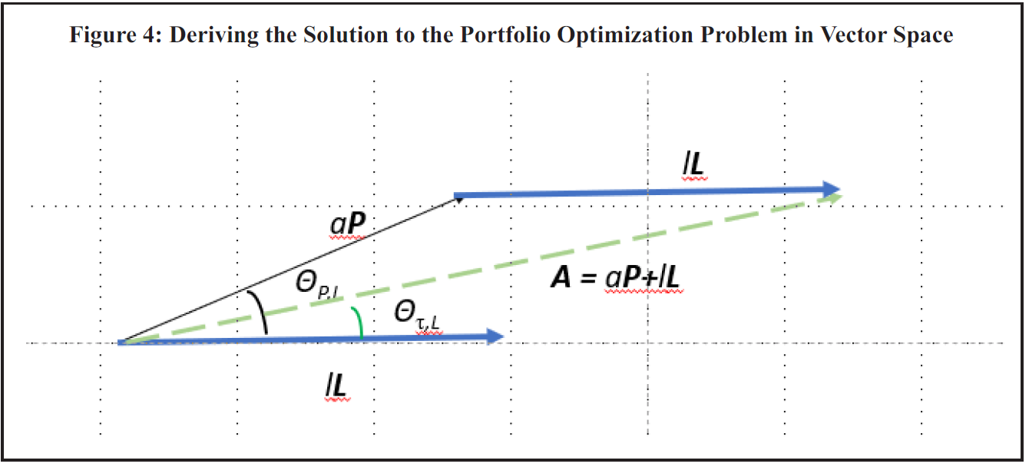
Vector Finance: Representing M-cube as a Vector
Muralidhar & Seigel · JPM Spring 2025
Dietz Award Best Paper
7

Slide 19
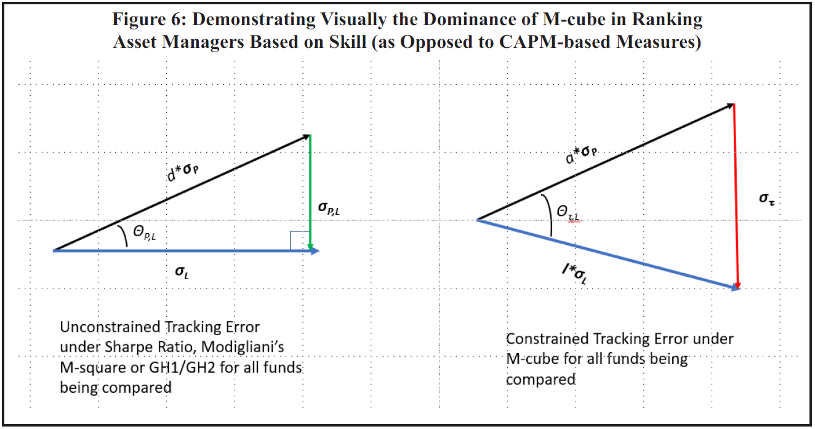
04 · VECTOR FINANCE
Visual Dominance of M-cube Over Sharpe / M² / GH
M-cube is the ONLY risk-adjusted performance measure equivalent to ranking managers by their confidence in skill.
Muralidhar & Seigel · JPM Spring 2025
Dietz Award Best Paper
9

Slide 20
05 – TIME-VARYING SKILL
Rodney Dangerfield on Looking Back..
I looked up my family tree
And found three dogs using it…
Muralidhar & Seigel · JPM Spring 2025
Dietz Award Best Paper
3

Slide 21
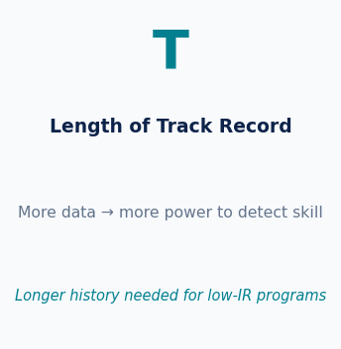
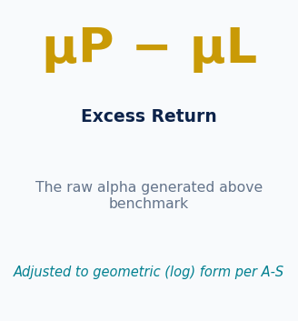
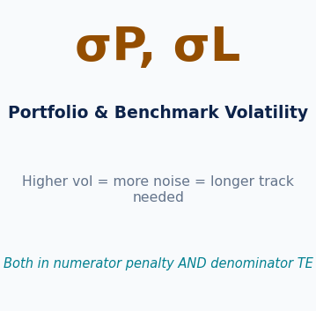
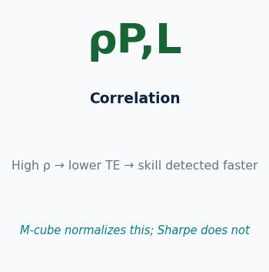
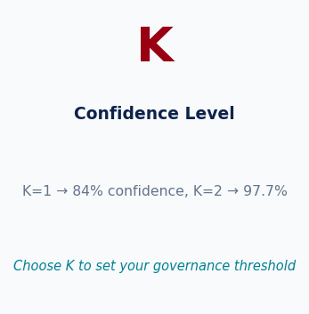
The Methodology: Time-Varying Confidence in Skill
Ambarish-Seigel (1996) · Muralidhar-U (1997) adaptation
Recall the Confidence in Skill Measure – Was reported over one time period
Why not have a running calculation?
The TVS Innovation
Rather than computing a single static number at the end of a track record, TVS recalculates CIS at every point in time as new data arrives — with an ever-extending window. This reveals trends: rising TVS signals improving processes; declining TVS flags deteriorating governance or luck-driven returns. Even with just 12 months of monthly data, well-managed programs can cross the 75% skill threshold.
Source: Muralidhar (2026). Ambarish & Seigel (1996). Muralidhar & U (1997).

Slide 22
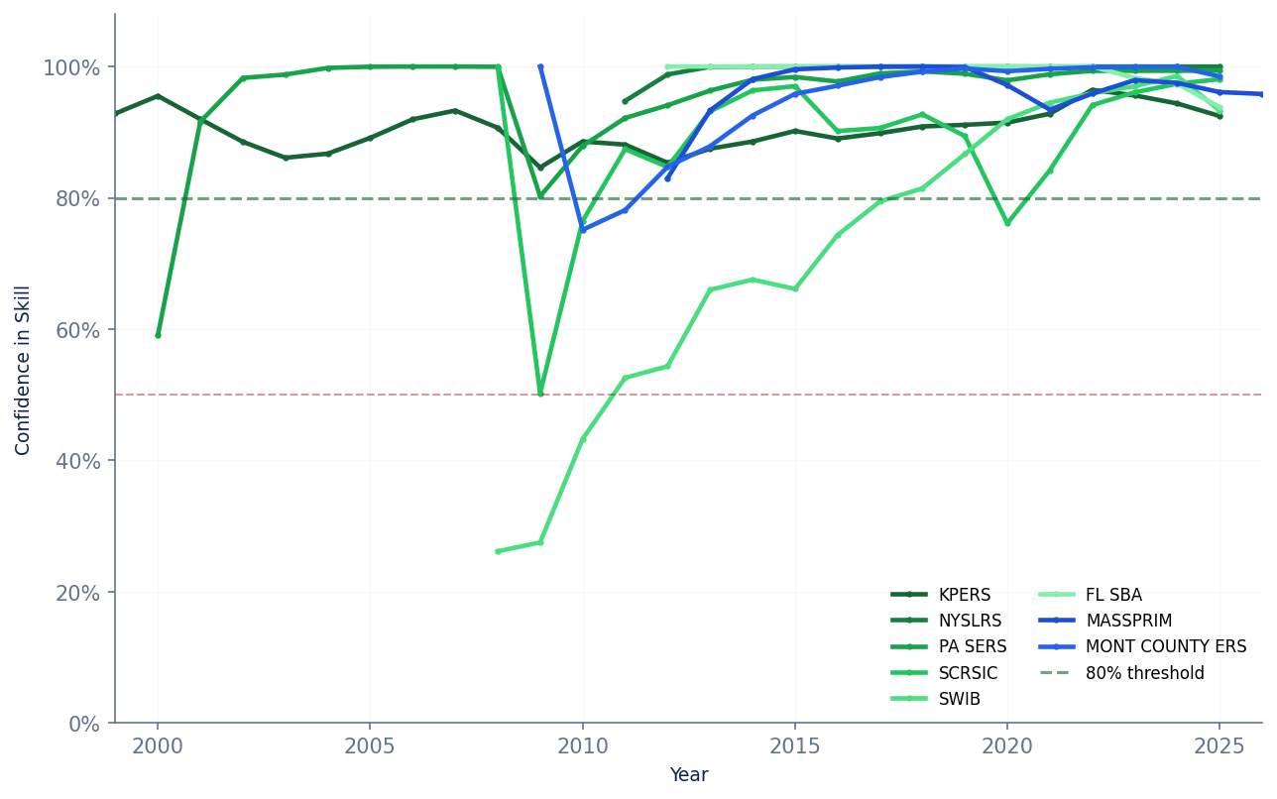
The Good: High and Rising Confidence in Skill
TVS ≥ 80% — sustained excellence
KPERS (Kansas)
35 years of data — longest track record. Steady ~90%+ CIS throughout. Model of consistent, disciplined governance.
PA SERS
26 years, CIS near 99%. Exceptional long-term excess returns with disciplined risk management.
NYSLRS
Hits 100% CIS — highest in the universe. Short track (15yr) but very strong excess/TE ratio.
SWIB (Wisconsin)
Dramatic improvement from 2007 base — a model of turnaround governance.
Key Insight: Consistent TVS >80% reflects sound investment processes, stable leadership, and effective governance.

Slide 23
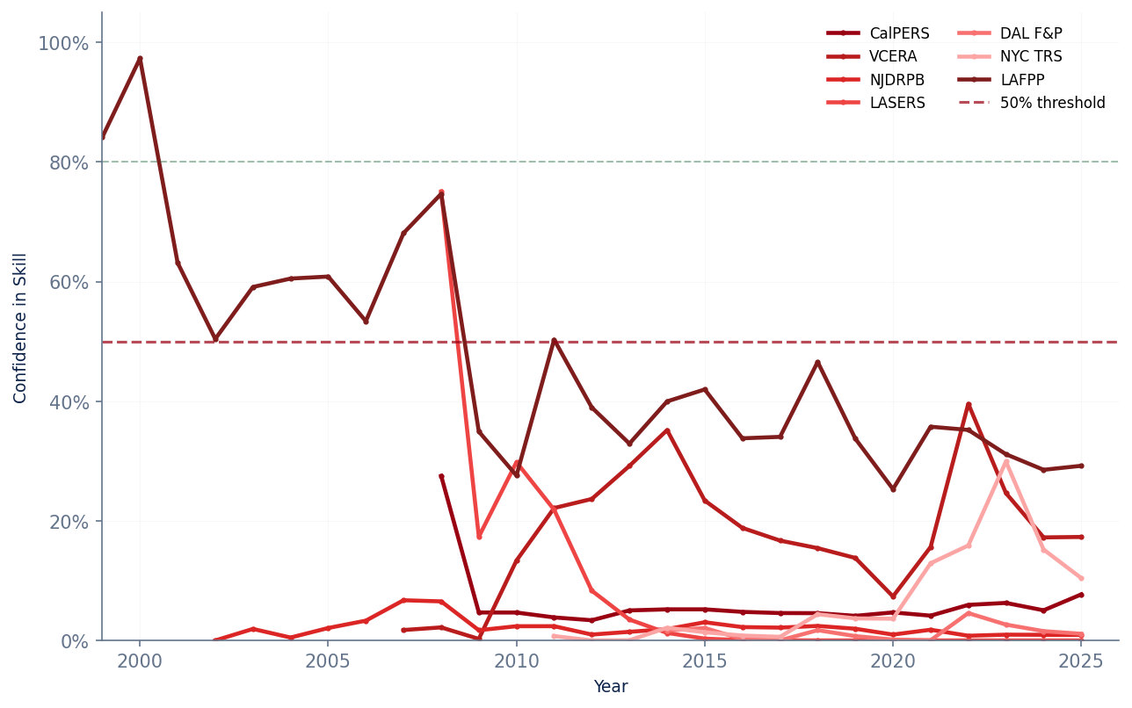
The Bad: Low and Declining Confidence in Skill
TVS < 50% — or steadily declining
CalPERS
Largest US fund ($464B). Revolving CIO door — multiple leadership changes. CIS barely above 7%. Governance failure.
LASERS (Louisiana)
CIS at 0%. Deeply negative excess vs benchmark. Systematic underperformance with high TE.
Dallas F&P
Only 12 years data but CIS 1.1%. Returns 2.9% vs peers at 7-9%. Serious concern.
VCERA (Ventura Co.)
Marked step-down in CIS post-2014 consultant switch (Aon/Ennis Knupp → NEPC).
Key Finding: Funds with consistently low TVS typically share governance failures — frequent CIO turnover, unclear mandates, or benchmark misalignment.

Slide 24
Conclusions & The Road Ahead
1. Portfolios Are Vectors
Volatility = magnitude, return direction = direction, combinations = vector addition. Finance theory gains a new geometric language.
2. Correlation Is a Cosine
The angle between two portfolio vectors encodes their correlation. Risk — tracking error — is the bi-vector length.
3. M-cube Is Geometrically Unique
Constraining TE = τ forces ALL managers to the same angle θ(τ,L). This is why M-cube rankings are identical to Ambarish-Seigel skill rankings.
4. CAPM Measures Are Insufficient
Sharpe, M², GH1/GH2 normalize volatility but leave correlation free — making cross-manager comparisons geometrically and mathematically invalid.
5. A New Field: Vector Finance
This framework extends to asset pricing, general equilibrium, and multi-goal investing. Geometry is the new language of finance.
"Those things which I am saying now may be obscure, yet they will be made clearer in their proper place." — Copernicus
Muralidhar & Seigel · JPM Spring 2025
Dietz Award Best Paper
12

Slide 25
🏆 Dietz Award — Best Paper 2025
Journal of Performance Measurement · Annual Conference
Thank You
Arun Muralidhar, Ph.D. & Lester Seigel, Ph.D.
Paper Citation
Muralidhar, A. and Seigel, L. (2025). "Explaining Risk-Adjusted Performance Using Vectors."
Journal of Performance Measurement, Spring 2025.
Muralidhar (2024) "Vectors in Finance" — SSRN abstract 5008334
Questions Welcome

